Slide 1
CSTE 2101: Object Oriented Programming with C++.

Slide 2
Reference Books:
Teach Yourself C++ by Herbert Schildt
Object Oriented Programming with C++ by E Balaguruswamy

Slide 3
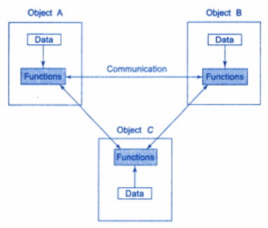
What is Object Oriented Programming?
Object Oriented Programming (OOP) allows decomposition of a problem into a number of entities called objects and then builds data and functions around these objects.

Slide 4
What is Object Oriented Programming?
C is a structured programming language.
Structured programming language relies on well-defined control structures, code blocks and stand-alone subroutine that support recursion and local variable.
The essence of structured programming language is the reduction of a program into its constituents parts.
Using Structured programming language, the average programmer can create and maintain programs that are up to 50,000 lines long.

Slide 5
Key features of OOP
Emphasize on data rather than procedure.
Programs are divided into what are known as object.
Data is hidden and cannot be accessed by external functions.
Objects may communicate with each other through functions.
New data and functions can be easily added whenever necessary.

Slide 6
All OOP languages, including C++, share three common defining characteristics:
Encapsulation
Polymorphism
Inheritance

Slide 7
Data Abstraction and Encapsulation
Encapsulation is the mechanism that binds together code and the data it manipulates, and keeps both safe from outside interference and misuse.
In an object-oriented language, code and data can be combined in such a way that a self-contained “black box” is created.
When code and data are linked together in this fashion, an object is created.
Within an object, code, data or both may be private to that object or public.

Slide 8
Data Abstraction and Encapsulation
Abstraction refers to the set of representing essential features without including the background details or explanations.
Classes use the concept of the abstraction and are defined as a list of abstract attributes such as size, weight and cost, and functions to operate on these attributes.
The attributes are sometimes called the data members because they hold information.
The function that operate on these data are sometimes called methods or member functions.

Slide 9
Data Abstraction and Encapsulation
As the classes use the concept of data abstraction, they are known as Abstract Data Types (ADT).

Slide 10
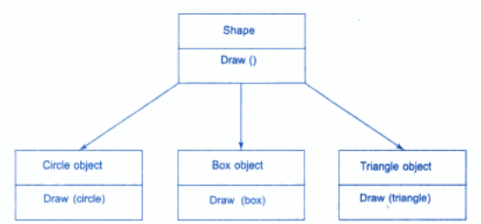
Polymorphism
Polymorphism is the quality that allow one name to be used for two or more related but technically different purpose.
Using single function name to perform different types of tasks is known as function overloading.

Slide 11
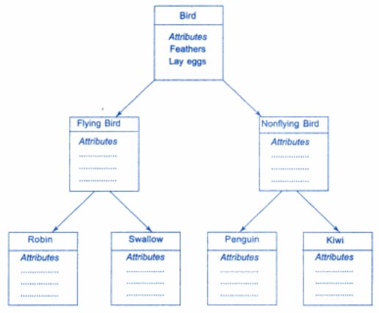
Inheritance
Inheritance is the process by which one object can acquire the properties of another.

Slide 12

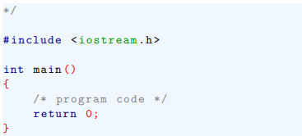
Two Version of C++
The difference between old-style and modern code involve two new features:
-- new style headers and
-- the namespace statement

Slide 13
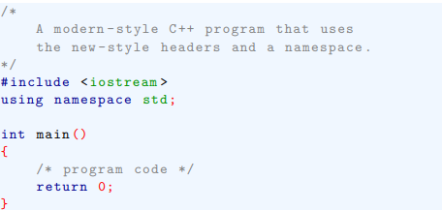
Two Version of C++
The difference between old-style and modern code involve two new features:
-- new style headers and
-- the namespace statement

Slide 14
The New C++ Header
here stdio.h is the name of the file used by the I/O functions, and the preceding statement cause that file to be included in your program.
The key point is that the #include statement include a file.

Slide 15
The New C++ Header
The new-style headers do not specify filenames.
Instead, they simply specify standard identifiers.
The new-style C++ headers are abstractions that simply guarantee that appropriate prototypes and definitions required have been declared.
Here some of the new-style headers:
<iostream>
<fstream>

Slide 16
Namespace
A namespace is simply a declarative region.
The purpose of a namespace is to localize the names of identifiers to avoid name collisions.
To bring the std namespace into visibility

Slide 17
C++ Console I/O
This statement causes the string to be displayed on the computer’s screen.
cout is a predefined stream that is automatically linked to the console when a C++ program begins execution.
By using the << output operator, it is possible to output any of C++’s basic types.

Slide 18

C++ Console I/O
In general, to output to the console, use this form of the <<operator;
To input the value from the keyboard, use the >> input operator.
In general,

Slide 19
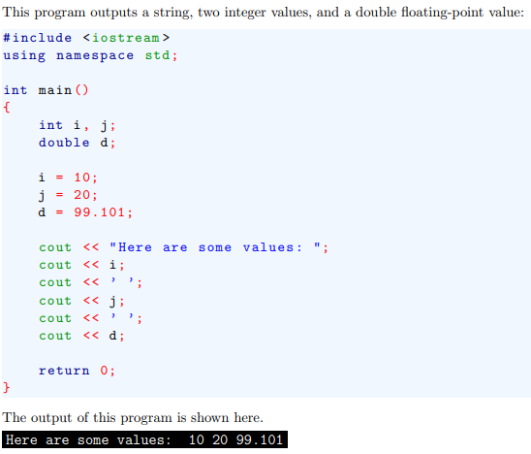
Example

Slide 20
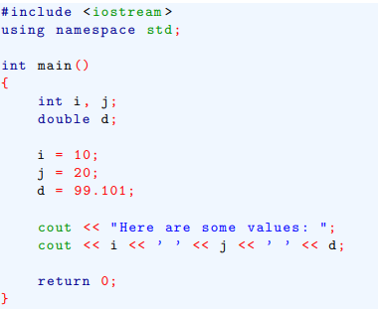
Example
It is possible to output more than one value in a single I/O expression.

Slide 21
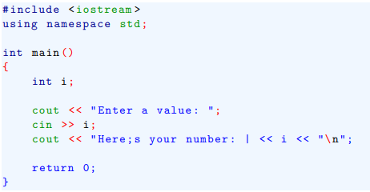
Example
This program prompts the user for an integer value.

Slide 22
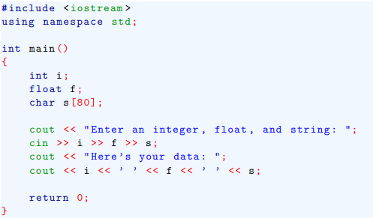
Example
This program prompts the user for an integer value, a floating-point value and a string.

Slide 23
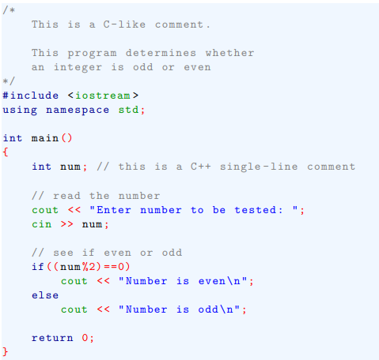
C++ comments

Slide 24

Some differences between C and C++
Another difference is that in C++, if a function is declared as returning a value, it must return a value.
In C, a non-void function is not required to actually return a value. If it doesn’t, a garbage value is “returned”.

Slide 25
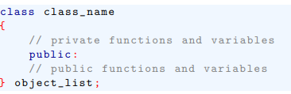
Introducing Class

Slide 26
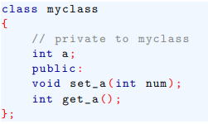
Introducing Class

